Slide 1
Transaction

Slide 2
What is transaction ?
When can you say a transaction is committed?
When can you say a transaction is aborted?
What is all-or-nothing property?
When you need a transaction to be rolled back?
Properties of transaction?
Concurrency control?
Inconsistency problem?

Slide 3
In some cases, clients require a sequence of separate requests to a server to be atomic:
1. They should not be interrupted by operations being performed on behalf of other concurrent clients.
2. Either all of the operations must be completed successfully or they must have no
effect at all in the presence of server crashes.

Slide 4
A client’s banking transaction
Transaction T:
a.withdraw(100);
b.deposit(100);
c.withdraw(200);
b.deposit(200);

Slide 5
Two aspects to atomicity:
1. All or nothing:
A transaction either completes successfully and the effects of all of its operations are recorded in the objects.
if it fails or is deliberately aborted has no effect at all.
Failure atomicity: The effects are atomic even when the server crashes.
Durability: After a transaction has completed successfully, all its effects are saved in permanent storage. Data saved in a file will survive if the
server process crashes.

Slide 6
2. Isolation:
Each transaction must be performed without interference from other transactions.
The intermediate effects of a transaction must not be visible to other transactions.

Slide 7
ACID property
Atomicity: a transaction must be all or nothing
Consistency: a transaction takes the system from one consistent state to another consistent state;
Isolation
Durability.

Slide 8
Transaction capabilities can be added to servers of recoverable objects.
Each transaction is created and managed by a coordinator.
The coordinator gives each transaction an identifier, or TID.
The client invokes the openTransaction method of the coordinator to introduce a new transaction – a transaction identifier or TID is allocated and returned.

Slide 9
At the end of a transaction, the client invokes the closeTransaction method to indicate its end .
All of the recoverable objects accessed by the transaction should be saved.
If, for some reason, the client wants to abort a transaction, it invokes abortTransaction method – all of its effects should be removed from sight.

Slide 10
Operations in the coordinator interface
openTransaction() -> trans;
Starts a new transaction and delivers a unique TID trans. This identifier will be used in the other operations in the transaction.
closeTransaction(trans) - > (commit, abort);
Ends a transaction: a commit return value indicates that the transaction has committed;
an abort return value indicates that it has aborted.
abortTransaction(trans);
Aborts the transaction.

Slide 11
Service actions related to process crashes
If a server process crashes it is replaced.
The new server process aborts any uncommitted transactions.
A recovery procedure used to restore the values of the objects to the values produced by the most recently committed transaction.
To deal with a client that crashes during a transaction, servers can give each transaction an expiry time and abort any transaction that has not completed before its expiry time.

Slide 12
Client actions related to server process crashes
client will become aware of this when one of the operations returns an exception after a timeout.
If a server crashes and is then replaced during the progress of a transaction, the transaction will no longer be valid and the client must be informed via an exception to the next operation.
In both the cases, the client need to decide by consulting with user of the transaction whether to complete or abandonment the part of the transaction.

Slide 13
Concurrency Control
The lost update problem:
Consider transactions on bank accounts A, B and C, whose initial balances are $100, $200 and $300, respectively.
Transaction T transfers an amount from account A to account B.
Transaction U transfers an amount from account C to account B.

Slide 14
Lost update problem
Transaction T:
balance = b.getBalance();
b.setBalance(balance*1.1);
a.withdraw(balance/10)
Transaction U:
balance = b.getBalance();
b.setBalance(balance*1.1);
c.withdraw(balance/10)

Slide 15
The lost update problem occurs when two transactions read the old value of a variable and then use it to calculate the new value.
This cannot happen if one transaction is performed before the other, because the later transaction will read the value written by the earlier one.

Slide 16
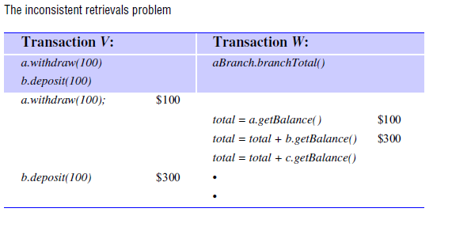
Inconsistent Retrievals problem

Slide 17
The inconsistent retrievals problem can occur when a retrieval transaction runs concurrently with an update transaction.
It cannot occur if the retrieval transaction is performed before or after the update transaction.

Slide 18
Conflicting operations
A pair of operations said to be conflicts if their combined effect depends on the order in which they are executed.
Consider a pair of operations, read and write.
read accesses the value of an object and write changes its value.
The effect of an operation refers to the value of an object set by a write operation and the result returned by a read operation.

Slide 19
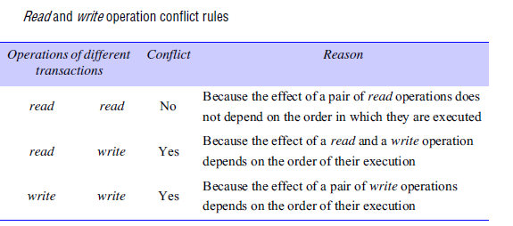

Slide 20
Serially equivalent transactions
Two transactions to be serially equivalent, it is necessary and sufficient that all pairs of conflicting operations of the two transactions be executed in the same order at all of the objects they both access.

Slide 21
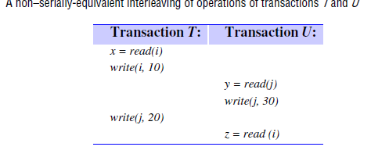

Slide 22
Transactions T and U, defined as follows:
T: x = read(i); write(i, 10); write(j, 20);
U: y = read(j); write(j, 30); z = read (i);
Each transaction’s access to objects i and j is serialized with respect to one another,because T makes all of its accesses to i before U does and U makes all of its accesses to j before T does.
But the ordering is not serially equivalent, because the pairs of conflicting operations are not done in the same order at both objects.
Serially equivalent orderings require one of the following two conditions:
1. T accesses i before U and T accesses j before U.
2. U accesses i before T and U accesses j before T.

Slide 23
Recoverability from aborts
The isolation property of transactions requires that transactions do not see the uncommitted state of other transactions.
The ‘dirty read’ problem is caused by the interaction between a read operation in one transaction and an earlier write operation in another transaction on the same object.
Consider T gets the balance of account A and sets it to $10 more.
U gets the balance of account A and sets it to $20 more.
The transaction T aborts after U has committed.
Then the transaction U will have seen a value that never existed, since A will be restored to its original value.
We say that the transaction U has performed a dirty read. As it has
committed, it cannot be undone.

Slide 24
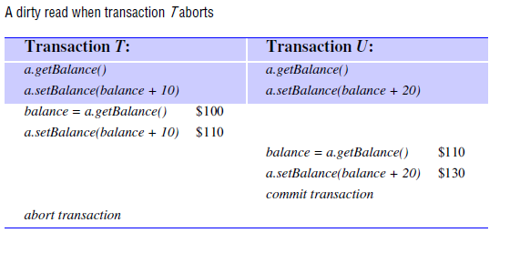

Slide 25
How to recover?
If a transaction (like U) has committed after it has seen the effects of a transaction that subsequently aborted, the situation is not recoverable.
So any transaction (like U) that is in danger of having a dirty read delays its commit operation until after the commitment of any other transaction whose uncommitted state has been observed.
In our example, U delays its commit until after T commits. In the case that T aborts, then U must abort as well.

Slide 26
Cascading aborts
U must also aborts if T aborts.
Unfortunately, if any other transactions have seen the effects due to U, they too must be aborted.
The aborting of these latter transactions may cause still further transactions to be aborted. Such situations are called cascading aborts.
To avoid cascading aborts, transactions are only allowed to read objects that were written by committed transactions.
Any read operation must be delayed until other transactions that applied a write operation to the same object have committed or aborted.

Slide 27
Strict executions of transactions
Generally, it is required that transactions delay both their read and write operations so as to avoid both dirty reads and premature writes.
The executions of transactions are called strict if it delays both read and write operations on an object until all transactions that previously wrote that object have either committed or aborted.
The strict execution of transactions enforces the desired property of isolation.

Slide 28
Tentative versions
All of the update operations performed during a transaction are done in tentative versions of objects in volatile memory.
Each transaction is provided with its own private set of tentative versions of any objects that it has altered.
All the update operations of a transaction store values in the transaction’s own private set.
The tentative versions are transferred to the objects only when a transaction commits and this value also recorded in permanent storage.
When a transaction aborts, its tentative versions are deleted.

Slide 29
Nested Transaction
Transactions to be composed of other transactions. That is several transactions may be started from within a transaction.
The outermost transaction in a set of nested transactions is called the top-level transaction.
Transactions other than the top-level transaction are called subtransactions.

Slide 30
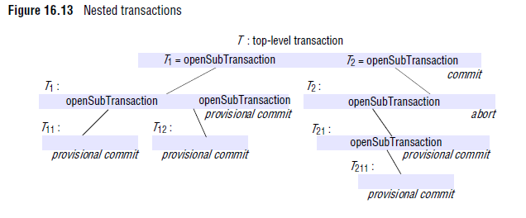

Slide 31
Sub transactions at the same level can run concurrently, but their access to common objects is serialized.
Each sub transaction can fail independently of its parent and of the other sub transactions.
When a sub transaction aborts, the parent transaction can sometimes choose an alternative sub transaction to complete its task.

Slide 32
Advantages of nested transaction
Sub transactions at one level may run concurrently with other sub transactions at the same level in the hierarchy.
This can allow additional concurrency in a transaction.
When sub transactions run in different servers, they can work in parallel.
Sub transactions can commit or abort independently.
with a flat transaction, one transaction failure would cause the whole transaction to be restarted or cascading abort.

Slide 33
The rules for committing of nested transactions
A transaction may commit or abort only after its child transactions have completed.
• When a sub transaction completes, it makes an independent decision either to commit provisionally or to abort. Its decision to abort is final.
When a parent aborts, all of its sub transactions are aborted.
For example, if T2 aborts then T21 and T211 must also abort, even though they may have provisionally
committed.
When a sub transaction aborts, the parent can decide whether to abort or not. In our example, T decides to commit although T2 has aborted.

Slide 34
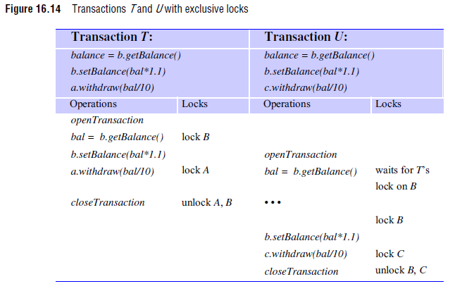
Locks

Slide 35
Two-phase locking:
The first phase of each transaction is a ‘growing phase’, during which new locks are acquired.
In the second phase, the locks are released which is called a ‘shrinking phase’.

Slide 36
Strict Two Phase Locking:
Any locks applied during the progress of a transaction are held until the transaction commits or aborts. This is called strict two-phase locking.
The presence of the locks prevents other transactions reading or writing the objects.
When a transaction commits, to ensure recoverability, the locks must be held until all the objects it updated have been written to permanent storage

Slide 37
The approach proposed by Kung and Robinson Transactions are allowed to proceed as there is no possibility of conflict with other transactions until the client completes its task and issues a closeTransaction request.
When a conflict arises, some transaction is aborted and will need to be restarted by the client.

Slide 38
Each transaction has the following phases:
Working Phase
Validation Phase
Update Phase

Slide 39
Working Phase:
During the working phase, each transaction has a tentative version of each of the objects that it updates.
This is a copy of the most recently committed version of the object.
The use of tentative versions allows the transaction to abort with no effect on the objects, during the working phase.

Slide 40
read operations are performed immediately – if a tentative version for that transaction already exists.
otherwise it accesses the most recently committed value of the object.
write operations record the new values of the objects as tentative values which are invisible to other transactions.
Two records :
read set: containing the objects read by the transaction.
write set :containing the objects written by the transaction.
Note that as all read operations are performed on committed versions of the objects (or copies of them) to avoid dirty reads.

Slide 41
Validation phase:
When the closeTransaction request is received, the transaction is validated to whether its operations conflict with operations of other transactions on the same objects.
If the validation is successful, then the transaction can commit.
If the validation fails, then Either the current transaction or those with which it conflicts will need to be aborted.
Update phase:
If a transaction is validated, all of the changes recorded in its tentative versions are made permanent.
Read-only transactions can commit immediately after passing validation.
Write transactions are ready to commit once the tentative versions of the objects have been recorded in permanent storage.

Slide 42
Validation of Transaction
Validation uses the read-write conflict rules to ensure that the scheduling of a particular transaction is serially equivalent with respect to all other overlapping transactions (Any transactions that had not yet committed at the time this transaction started)
Each transaction is assigned a transaction number when it enters the validation phase.
If the transaction is validated and completes successfully, it retains this number.
If it fails the validation, or if the transaction is read only, the number is released for reassignment.
Transaction numbers are integers assigned in ascending sequence.
a transaction with the number Ti always precedes a transaction with the number Tj if i < j.

Slide 43
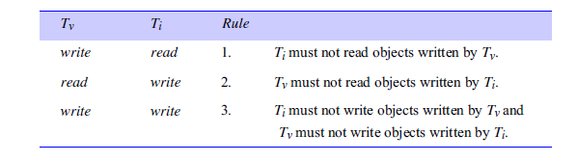
For a transaction T_{v} to be serializable with respect to an overlapping transaction T_{i}, their operations must conform to the following rules:

Slide 44
Need to ensure that only one transaction is in the validation and update phase at one time.
When no two transactions may overlap in the update phase, rule 3 is satisfied.

Slide 45
Two forms of validation
Backward validation :
checks the transaction undergoing validation with other preceding overlapping transactions which have entered the validation phase before it.
Forward validation:
checks the transaction undergoing validation with other later transactions, which are still active.

Slide 46
Backward Transaction
As all the read operations of earlier overlapping transactions were performed before the validation of Tv started, they cannot be affected by the writes of the current transaction (and rule 1 is satisfied).
The validation of transaction Tv checks whether its read set overlaps with any of the write sets of earlier overlapping transactions, Ti (rule 2). If there is any overlap,the validation fails.

Slide 47
Comparison of methods of concurrency control
1. Dropbox :
It is a cloud service that provides file backup and enables users to share files and folders, accessing them from anywhere.
Dropbox uses an optimistic form of concurrency control, keeping track of consistency and preventing clashes between users’ updates.
If two users make concurrent updates to the same file, the first write will be accepted and the second rejected.
However, Dropbox provides a version history to enable users to merge their updates manually or restore previous versions.

Slide 48
2. Google apps:
Provides web-based applications that allow users to collaborate with one another by means of shared documents.
If several people edit the same document simultaneously, they will see each other’s changes.
In the case of a word processor document, users can see one another’s cursors and updates are shown at the level of individual characters as they are typed by any participant.
Users are left to resolve any conflicts that occur, but conflicts are generally avoided because users are continuously aware of each other’s activities.
In the case of a spreadsheet document, users’ cursors and changes are displayed and updated at the granularity of single cells.
If two users access the same cell simultaneously, the last update wins

Slide 49
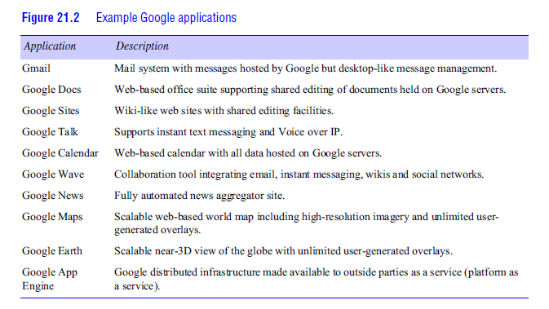

Slide 50
Wikipedia •
Concurrency control for editing is optimistic, allowing editors concurrent access to web pages in which the first write is accepted and a user making a subsequent write is shown an ‘edit conflict’ screen and asked to resolve the conflicts.
Dynamo :
Amazon.com’s key-value storage service uses optimistic concurrency control with conflict resolution

Slide 51
Two phase Commit Protocols
During the progress of a transaction, there is no communication between the coordinator and the participants apart from the participants informing the coordinator when they join the transaction.
A client’s request to commit (or abort) a transaction is directed to the coordinator.
If the client requests abortTransaction, or if the transaction is aborted by one of the participants, the coordinator informs all participants immediately.

Slide 52
In the first phase of the two-phase commit protocol the coordinator asks all the participants if they are prepared to commit.
in the second phase, it tells them to commit (or abort) the transaction.
If a participant can commit its part of a transaction, it will agree as soon as it has recorded the changes it has made (to the objects) and its status in permanent stroage.

Slide 53
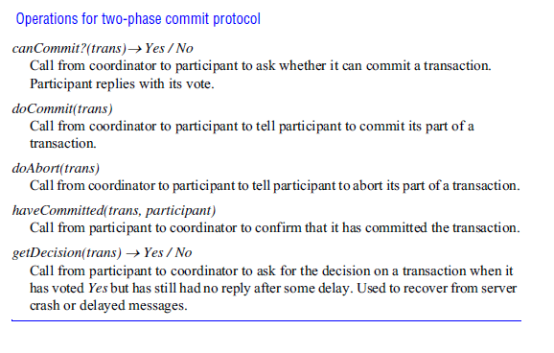

Slide 54
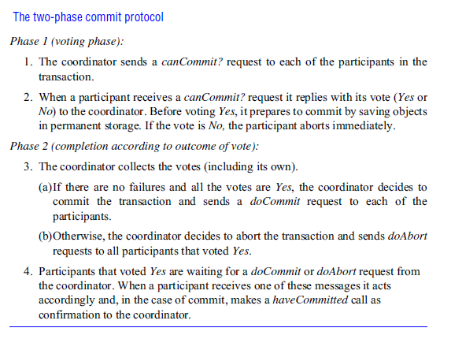

Slide 55
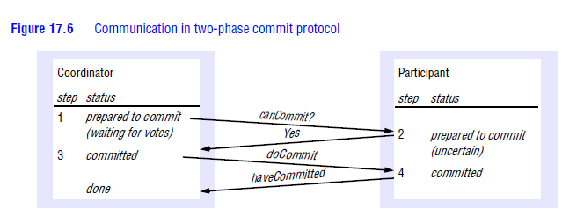

Slide 56
Concurrency control in distributed transaction
In a distributed transaction, the locks on an object are held locally (in the same server).
The local lock manager can decide whether to grant a lock or make the requesting transaction wait.
However, it cannot release any locks until it knows that the transaction has been committed or aborted at all the servers involved in the transaction.
When locking is used for concurrency control, the objects remain locked and are unavailable.

Slide 57
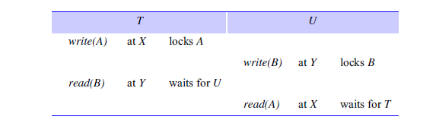
Consider the following interleaving of transactions T and U at servers X and Y:

Slide 58
The transaction T locks object A at server X, and then transaction U locks object B at server Y.
After that, T tries to access B at server Y and waits for U’s lock. Similarly, transaction U tries to access A at server X and has to wait for T’s lock.
Therefore, we have T before U in one server and U before T in the other.
These kind of cyclic dependencies between transactions leads to a distributed deadlock.
When a deadlock is detected, a transaction is aborted to resolve the deadlock.
In this case, the coordinator will be informed and will abort the transaction at the participants involved in the transaction.

Slide 59
In a single server transaction, the coordinator issues a unique timestamp to each transaction when it starts.
Serial equivalence is enforced by committing the versions of
objects in the order of the timestamps of transactions that accessed them.
In distributed transactions, we require that each coordinator issue globally unique timestamps.
A globally unique transaction timestamp is issued to the client by the first coordinator accessed by a transaction.
The transaction timestamp is passed to the coordinator at each server whose objects perform an operation in the transaction.

Slide 60
For example consider the version of an object accessed by transaction U commits after the version accessed by T at one server.
if T and U access the same object as one another at other servers they must commit them in the same order.

Slide 61
If the resolution of a conflict requires a transaction to be aborted, the coordinator will be informed and it will abort the transaction at all the participants.
Therefore any transaction that reaches the client request to commit should always be able to commit, and participants in the two-phase commit protocol will normally agree to commit.
The only situation in which a participant will not agree to commit is if it has crashed during the transaction

Slide 62
each transaction is validated before it is allowed to commit.
Transaction numbers are assigned at the start of validation and transactions are serialized according to the order of the transaction numbers.
A distributed transaction is validated by a collection of independent servers, each of which validates transactions that access its own objects.
This validation takes place during the first phase of the two-phase commit protocol

Slide 63
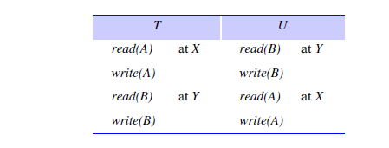

Slide 64
The transactions access the objects in the order T before U at server X and in the order U before T at server Y.
Now suppose that T and U start validation at about the same time, but server X validates T first and server Y validates U first.
The rule says that only one transaction may perform validation and update phases at a time.
Therefore each server will be unable to validate the other transaction until the first one has completed. This is an example of commitment deadlock.

